Slide 1
Section 1.2 Graphs of Equations in Two Variables; Circles
Lecture 1
Curves in the Plane
Graph Features

Slide 2
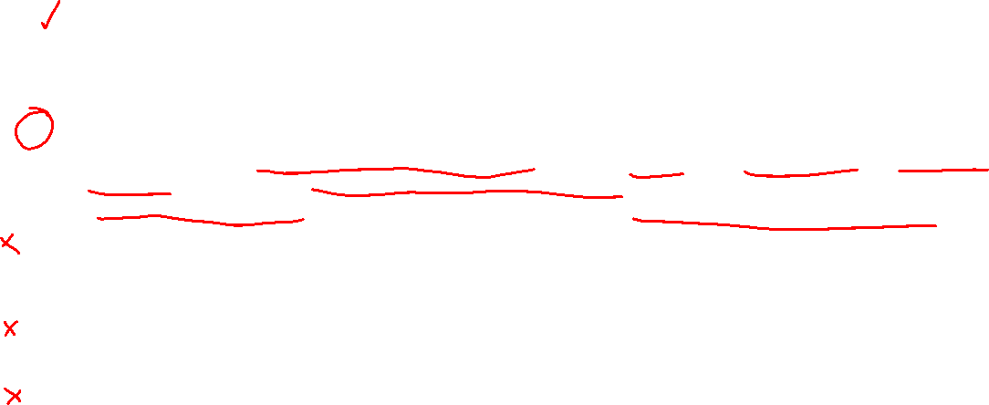
Section 1.2 Homework Submission to Canvas
Preview of section
Skim the section in text and write a short paragraph summary.
Give a bulleted list of all important definitions, theorems, and formulas without details.
Notes on video lectures
Take notes on everything written on slides including all details, worked examples, on-own activities, as well as your own thoughts and questions.
Try on-own activities first, then write down provided solution next to it for comparison.
Worked examples from the text
Write down the problem and attempt without looking at the solution.
Use the solution to write the best explanation you can.
Solutions to textbook exercises
Model approaches and explanations given in the video lectures and textbook examples.
Final reflection of section
List the key takeaways to remember as a bulleted list.

Slide 3
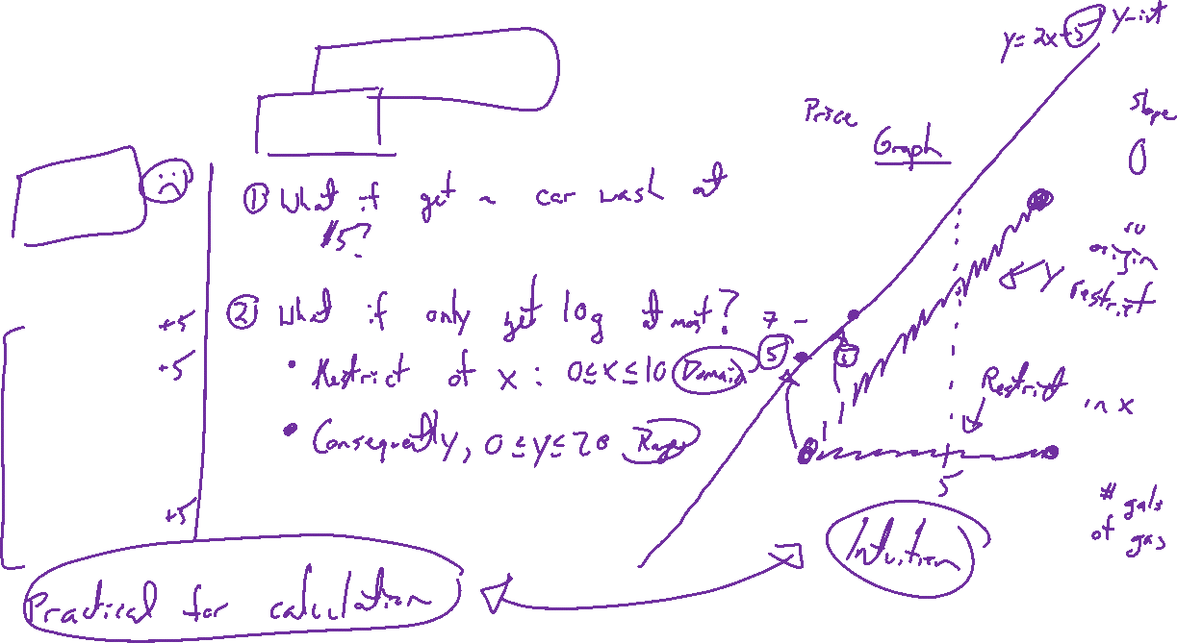
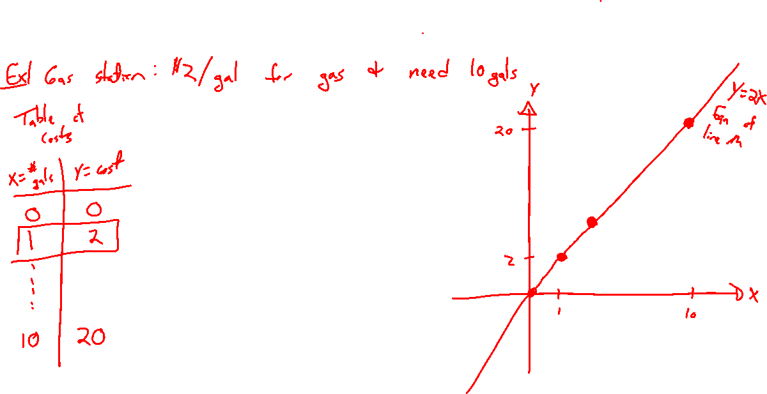
Motivation: Equations and Graphs
Notes:
Example: Gas at the pump.
Plot points, generalize to equation of line (considering all points at once).
What if:
- know tank capacity? Domain and range
- add car wash?

Slide 4
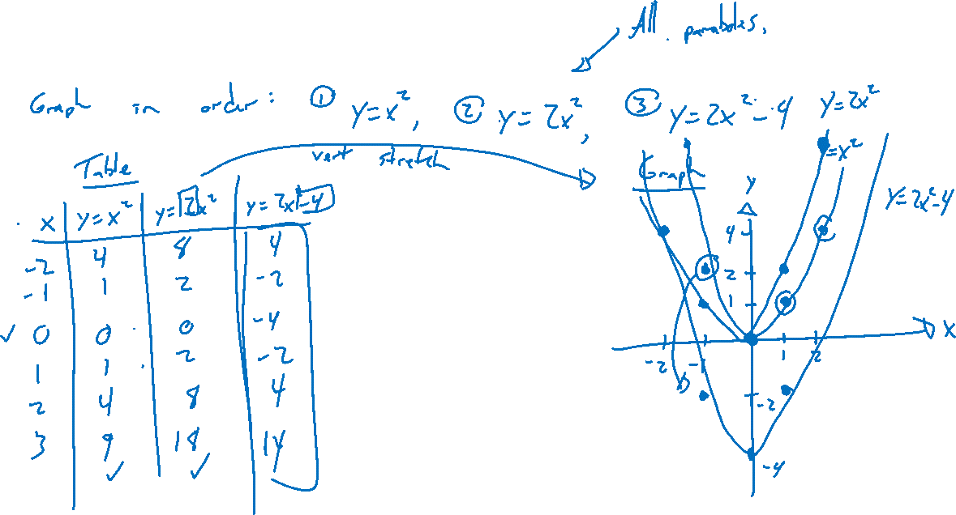
Graph Inuition: Try on Own
Notes:
Graph in order, give reasoning
Y=x^2, y=2x^2, y=2x^2-4
Domain, range, intercepts, symmetry

Slide 5
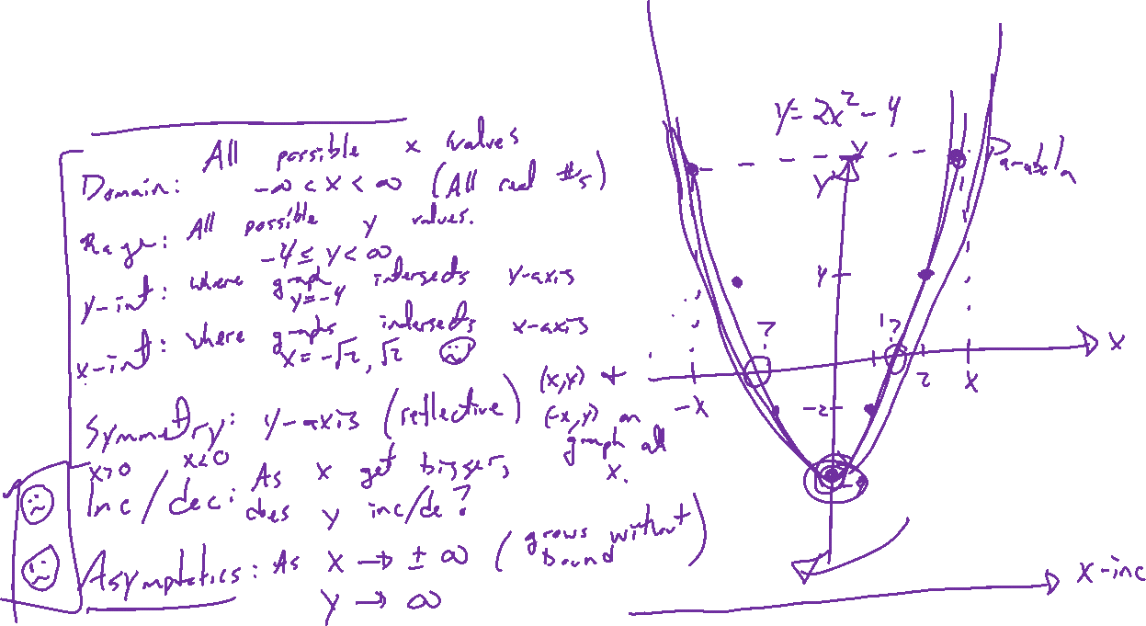
Graph Features
Notes:
y=2x^2-4
Domain, range, intercepts, symmetry (x, y, rotational, how to check?)
Must there be intercepts / symmetry? No
Trending: as x goes to +-infinity, what happens to y? Asymptotes

Slide 6
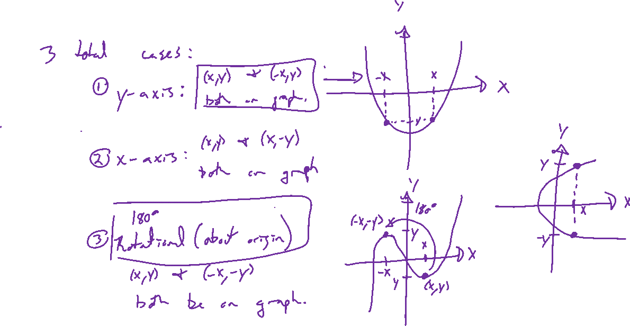
Graph Symmetry
Notes:
3 cases (x y axis, rotational)
Draw each, how to define / check must be true.

Slide 7
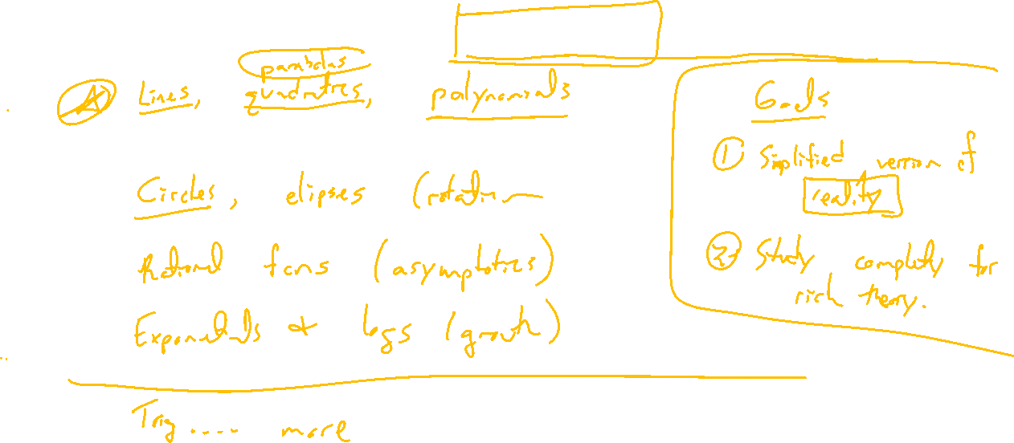
Important Classes of Equations and Graphs
Notes:
Lines (next section), parabolas (quadratic), polynomials (next chapters)
Circles
Rationals (chapter 3)
Exponential, logarithm (chapter 4)
Trigonometric (precalc)
More...
Serve 2 purposes:
- simplification of reality which allow us to better understanding
- examples which we can study completely to develop rich theory

